Slide 1
DECIPHERING Life Expectancy… USING ML
Shubham Dandak

Slide 2
Agenda
Introduction
Understanding the dataset
Shape of dataset
Understanding columns
Factors affecting Life Expectancy
Libraries and tools used
Data cleaning
Data visualisation
Model building
Inferences from dataset
Q&A

Slide 3
INTRODUCTION
Life Expectancy is an estimate of average number of additional years that a person of a given age can expect to live. It varies from country to country and depends on social, political and geographical factors prevailing in that country.
Link for dataset:
https://github.com/shubh4515/Life_Expectancy_regression_model/blob/main/Life%20Expectancy%20Data.csv

Slide 4
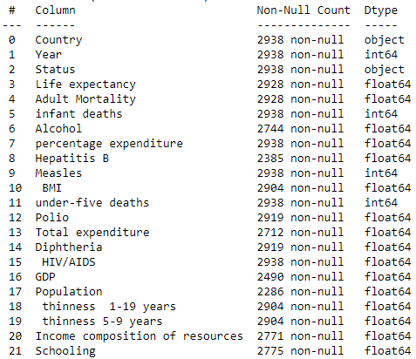
UNDERSTANDING DATASET
The target column needs Regression analysis,
There are 2938 rows and 22 columns in our dataset,
Life expectancy is dependent variable which depends on other independent variable
For more details refer:
https://github.com/shubh4515/Life_Expectancy_regression_model/blob/main/README.md

Slide 5
LIBRARIES AND TOOLS USED:
Pandas: For data analysis, data manipulation, and cleaning of data,
NumPy: To deal with numerical part of our dataset,
Matplotlib.pyplt: For visualization and potting figures,
Seaborn: To plot heat map and other co relational figures,
Train_test_split: To split the data into training and testing,
SimpleImputer: To impute missing values,
Ridge, Decision tree, Random Forest for model building
For more details:
https://github.com/shubh4515/Life_Expectancy_regression_model/blob/main/Life_expectancy.ipynb

Slide 6
Questions to be answered
Does various predicting factors which has been chosen initially really affect Life expectancy? What are the predicting variables actually affecting life expectancy?
Should a country having a lower life expectancy value(<65) increase its healthcare expenditure in order to improve its average lifespan?
How do Infant and Adult mortality rates affect life expectancy?
Does Life Expectancy has a positive or negative correlation with eating habits, lifestyle, exercise, smoking, drinking alcohol etc?
What is the impact of schooling on the lifespan of humans?
Does Life Expectancy have a positive or negative relationship with drinking alcohol?
Do densely populated countries tend to have lower life expectancy?
What is the impact of Immunization coverage on Life Expectancy?
For go through EDA part:
https://github.com/shubh4515/Life_Expectancy_regression_model/blob/main/Life_expectancy_EDA%20.ipynb

Slide 7
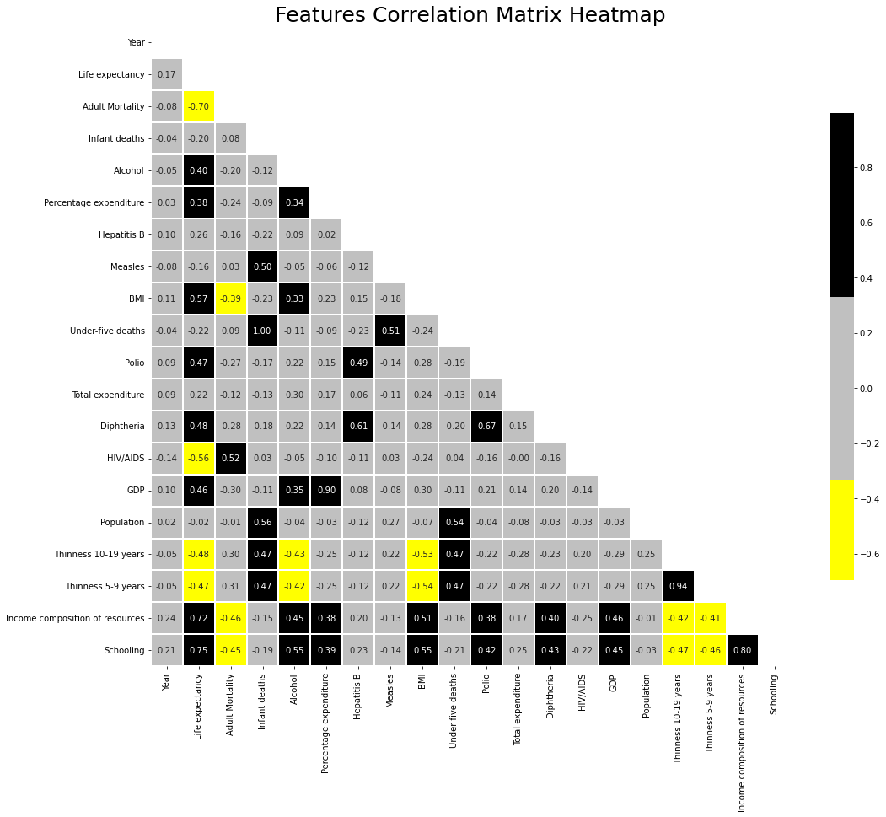
Inferences from Dataset

Slide 8
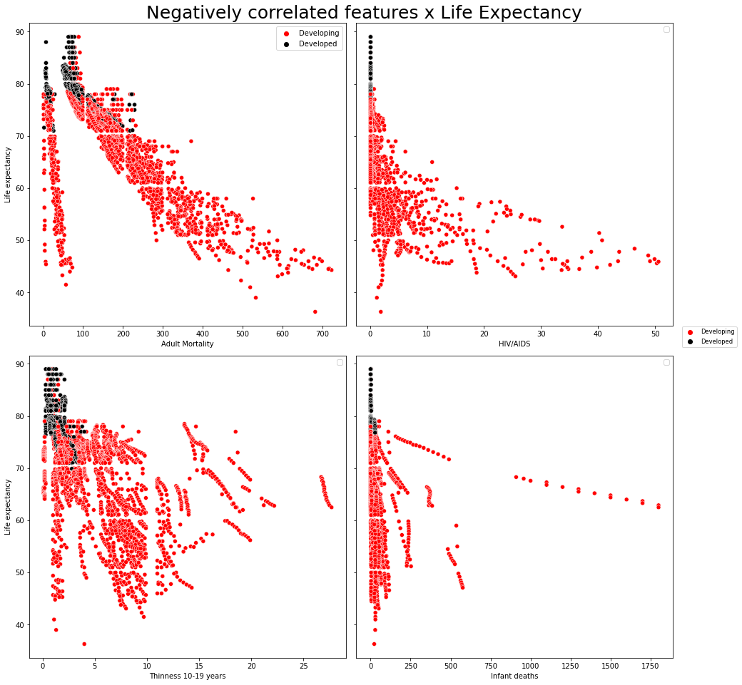
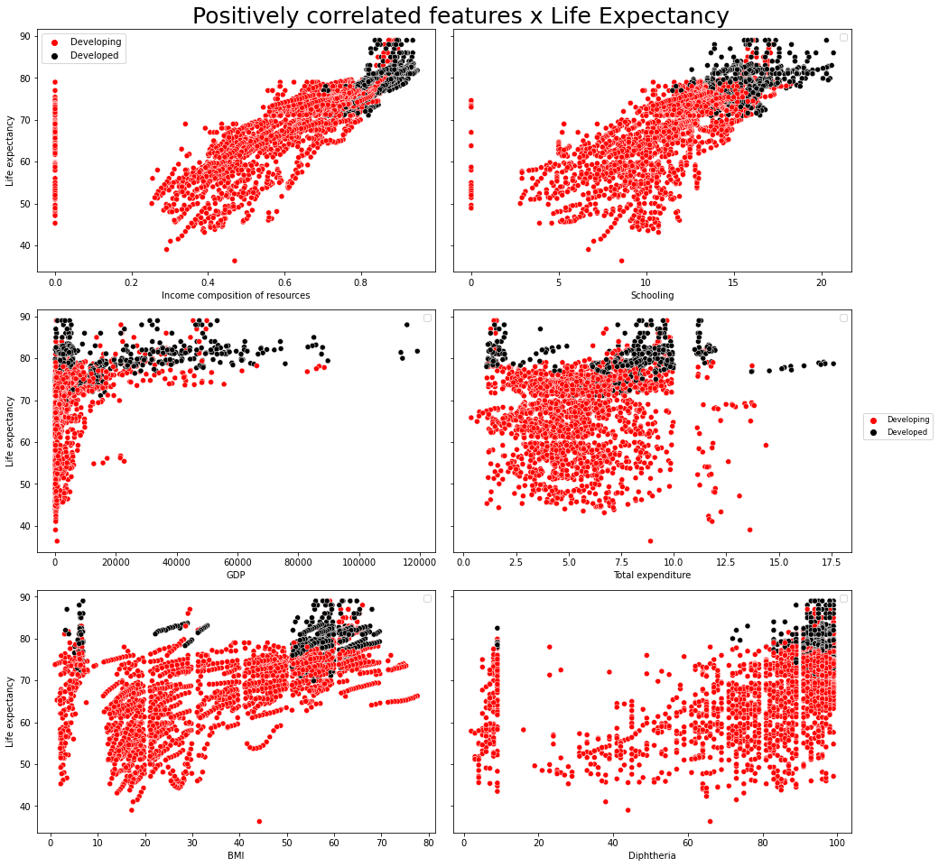
Inference 1:
Positive correlation with life expectancy:
Alcohol = 40%
Percentage expenditure = 38%
Hepatitis B = 26%
Total expenditure = 22%
Strong positive correlation with life expectancy:
Schooling = 75%
Income composition of resources = 72%
BMI = 57%
Diphtheria = 48%
Polio = 47%
GDP = 46%
Negative correlation with life expectancy:
Adult mortality = -70%
HIV/AIDS = -56%
Status = -48%
Thinness 5-19 years = -48%
Infant deaths = -20%
Population = -2%

Slide 9


Q2. Should a country having a lower life expectancy value(<65) increase its healthcare expenditure in order to improve its average lifespan?
Inference 2-
All the countries in given dataset with life expectancy below 65 years are developing countries
Common observation among this countries:
This countries have lower Total expenditure on health compared to developed nations,
The income composition in this countries is also lower than that of developed countries.
So Government need to increase the expenditure on healthcare so that the life expectancy can be enhanced in this countries where life expectancy is below 65 years.
Age>65 and total expenditure:
Age<65 and total expenditure:

Slide 10
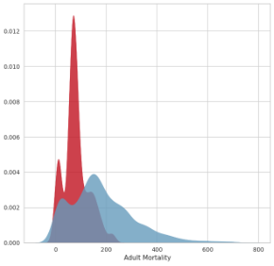
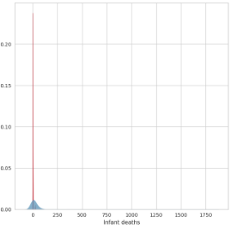
Q3. How do Infant and Adult mortality rates affect life expectancy?
Inference 3-
The life expectancy is negatively correlated with infant mortality, under-five deaths and adult mortality
Infant deaths = -16%
Adult mortality = -70%
That means life expectancy is inversely proportional with infant and adult mortality.
The countries with lower Life Expectancy have -
Higher Infant mortality
Higher adult mortality
Developing status
So as infant deaths and adult mortality increases life expectancy decreases and vice versa.

Slide 11
Q4. Does Life Expectancy has a positive or negative correlation with eating habits, lifestyle, exercise, smoking, drinking alcohol etc?
Inference 4:
Alcohol
From available dataset we can infer that alcohol consumption is more in developed countries, and life expectancy is also high in developed countries. So for this countries alcohol consumption is not impacting much to life expectancy. And from heat map too we can observe alcohol has 40% positive correlation with Life Expectancy.
Eating habits
Although Eating habits is not a direct column in our dataset but we are having related columns like Income composition of resources, BMI tells us indirectly about eating habits i.e. with increase in income eating habit generally increase. Apart from this quality of eating habit i.e. healthy food or junk food is related to BMI,
Healthy food keeps BMI in optimum range
Junk food distort BMI and leads to distorted BMI
In developed countries because of good income, people can afford food and comparatively healthy population,
In developing countries especially poor developing countries under nourishment, Child Stunting, Child wasting is commonly visible and that is because the people there do not have access of healthy food.
Life style and exercise
Lifestyle and Exercise are positively correlated with Life Expectancy when life style is active and people do physical exercise and it becomes negatively related when sluggish lifestyle and no physical exercise is there.
Smoking
Smoking has negative correlation with Life Expectancy, i.e. smoking increases health related risks and which reduces life expectancy.

Slide 12

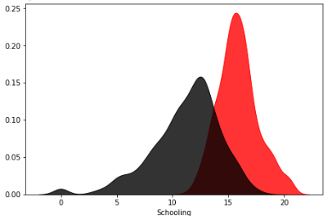
Q5. What is the impact of schooling on the lifespan of humans?
Inference 5:
Education has potential to change the living standard of people directly, and it can be seen from our dataset too.
Schooling and life expectancy are highly positive correlated i.e. 75%.
Means Schooling increases life expectancy at a large extent.
The scatter plot also gives us the correlation among Life Expectancy and Schooling i.e. Life Expectancy is really high in those countries where schooling is also high.
Q6. Does Life Expectancy have a positive or negative relationship with drinking alcohol?
Inference 6:
Although a general perception states that consumption of alcohol has injurious effect on one's health.
But in given dataset the consumption of alcohol has 40% correlation with Life expectancy and in developed countries consumption of alcohol is not affecting the Life Expectancy.

Slide 13
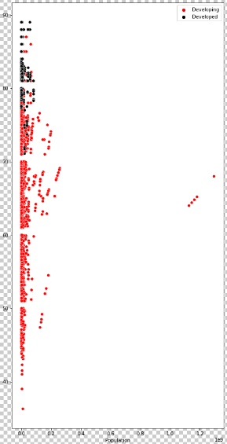
Q7. Do densely populated countries tend to have lower life expectancy?
Inference 7:
Although to calculate the population density of a particular country we also require geographical area of that country.
Since Geographical area is now mentioned in our dataset so we will take population as a reference to see impact of population density on life expectancy.
In our dataset we have overall 32 developed countries and out of those 32, 21 developed countries having population above median.
Also we have overall 161 developing countries and out of those 161 countries 91 countries have population above the median.
So from available data if we go numerically than population seems not that influencing factor for lower life expectancy, instead other factors plays much more important role.
Although if we go with general perception the countries with highest population density which is concentrated in South East Asia like Bangladesh, India are having very high population density and life expectancy below developed countries like USA, Japan and European countries. So by this interpretation Life Expectancy depends on population density too.

Slide 14
Q8. What is the impact of Immunization coverage on Life Expectancy?
Inference 8:
Immunization is intended to protect the population from life threatening diseases like Hepatitis B, Measles, Polio, Diphtheria.
From the dataset we can infer that Hepatitis B, Polio and Diphtheria are positively correlated with Life Expectancy and if the population can be made immune by vaccination or some other measure from this life threatening diseases than Life expectancy can be improved.
Immunization will reduce infant, under five and adult mortality too which will ultimately increase life expectancy.
And developed countries because of availability of proper health infrastructure the prevalence of diseases is minimal and life expectancy is higher.
So immunization coverage can improve life expectancy.
For go through EDA part:
https://github.com/shubh4515/Life_Expectancy_regression_model/blob/main/Life_expectancy_EDA%20.ipynb

Slide 15
Thank you

